Slide 1
BIG DATA ANALYTICS PROJECT
Retail Demand Forecasting and Inventory Optimization
From spreadsheet to a reproducible analytics workflow: PostgreSQL, Python, Databricks, Delta Lake and Power BI
Faculty guide: Dr. Butchi Babu Muvva | Course: Big Data Analytics
Synthetic retail data | 1 Jan – 29 Feb 2024
Notes:
Introduce the project: an integrated analytics workflow on a synthetic retail dataset. Add your name, programme and institution before presenting.

Slide 2
Executive summary
₹1.40 Cr
141,189
2,015
₹29.8 L
Recorded revenue (₹13,969,230)
Units sold
Estimated unmet demand units
Estimated gross profit
6,000 records, 60 days, 5 stores, 20 products, 5 cities
Zero missing cells and zero duplicate rows
Top city: Secunderabad. Top category: Grocery. Top product: Toor Dal 1kg
Prototype only: the data is synthetic and covers just two months
Notes:
Headline numbers come straight from the Retail Sales Data sheet. Gross profit is an estimate: revenue minus units sold times unit cost.

Slide 3
The problem and our objectives
1
Profile data quality
Business question
Row counts, nulls, duplicates, key checks
How can store–product sales history, calendar and promotion fields support a repeatable demand forecast and better inventory review?
2
Model and query data
PostgreSQL schema plus SQL analytics
3
Forecast demand
Too little stock means unmet demand. Too much ties up cash and raises waste. Outputs trigger review, not automatic orders.
Python baseline on a chronological holdout
4
Scale and report
Spark / Delta workflow and Power BI dashboard
Notes:
Out of scope: live POS integration, streaming, MLOps, causal proof of promotion effects and automated replenishment.

Slide 4
Solution architecture
Excel / CSV
Python
PostgreSQL + DBeaver
Databricks + Delta
Power BI
›
›
›
›
Source data
Validate, profile, forecast
Schema and SQL analytics
Bronze, Silver, Gold
Executive dashboard
Relational model
Execution status
dim_product and dim_store hold descriptive attributes
fact_retail_sales at date × store × product grain
Foreign keys and indexes protect integrity
This is the target architecture. Components are marked complete only when a run is evidenced; a diagram alone is not proof of a live connection.
Notes:
DBeaver is only the SQL client; PostgreSQL is the database engine. Databricks provides distributed compute, Delta Lake the reliable table format.

Slide 5
Dataset and data quality
Retail Sales Data
6,000 × 18
Validation checks (all passed)
0 missing cells
0 exact duplicate rows
0 negative units or revenue
0 revenue arithmetic mismatches
60 days, 1 Jan – 29 Feb 2024
Product Master
20 × 5
Store Master
5 × 3
Project Guide
11 × 2
Caveat: opening stock, restocks, sales and closing stock must still be tested against a stock-flow equation before trusting stockout signals.
Notes:
Grain is intended to be one row per date, store and product. This must be tested, not assumed.

Slide 6
Where revenue comes from
Secunderabad leads cities; Grocery alone is about 40% of revenue. Rankings are descriptive and reflect synthetic data design.
Notes:
Grocery 5,624,615.80 of 13,969,230.40 total = about 40%. Revenue leadership does not imply highest margin or most urgent inventory need.

Slide 7
Top products and promotion effect
Promotion rows
+29.2%
more average units per row (29.47 vs 22.81)
Not a causal lift: product mix, dates and pricing differ between groups. Use matched comparisons next.
Notes:
648 promotion rows versus 5,352 non-promotion rows. Average revenue per row: ₹2,645.83 vs ₹2,289.75.

Slide 8
Forecasting baseline and results
4.20
5.63
17.86%
80 / 20
MAE (units per row)
RMSE (units)
MAPE (non-zero actuals)
Chronological train / test split
Method
Before relying on it
Random Forest regressor (scikit-learn)
Target: daily units sold per store-product
Features: calendar, store, product, category, promotion
4,800 training rows, 1,200 test rows
Beat a naive baseline (same-day last week)
Add lag and rolling features, rolling backtests
Two months cannot validate annual seasonality
Re-run pipeline to confirm final metrics
Notes:
Metrics are those recorded in the project's output file. A time-ordered split avoids using future observations to predict the past.

Slide 9
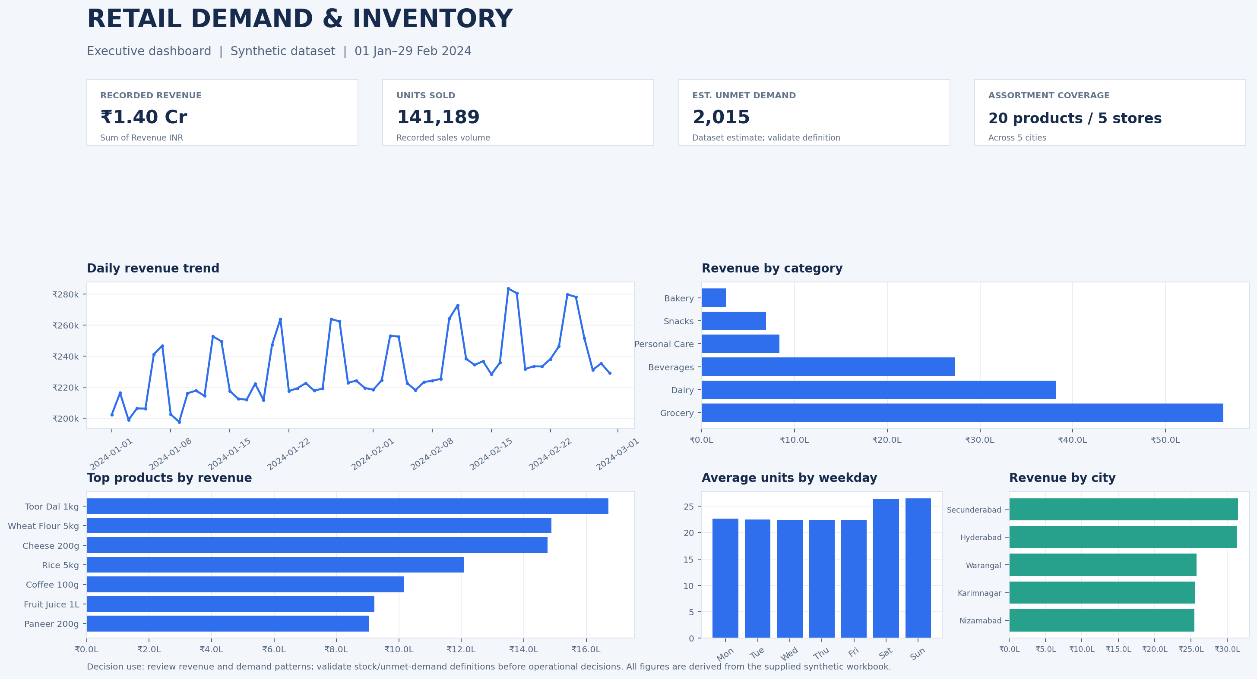
Dashboard and recommendations
1
Daily exception list
for non-zero unmet demand
2
Review top products
at store level for availability and margin
3
Matched promotion tests
instead of raw averages
4
Backtest before piloting
vs a naive forecast
Executive dashboard prototype (static image, not a published .pbix)
5
Add lead time and order limits
before any reorder logic
Notes:
30-day pilot: week 1 validate definitions, week 2 reconcile SQL and Power BI, week 3 backtest, week 4 human-reviewed replenishment pilot against a control.

Slide 10
Conclusion and future work
Trustworthy definitions, a correct grain, chronological evaluation and reconciled KPIs matter more than the choice of algorithm or dashboard tool.
Next steps
Key limits
Replace synthetic data with real retail history
Add lag features and seasonal-naive baselines
Run Databricks notebook, capture Delta evidence
Synthetic, two-month dataset
Unmet-demand definition unverified
Not production-ready; no verified financial gain
Thank you | Questions?

